Slide 1
Building South Africa’s Future
From the Bottom Up
Through Children, Communities, Youth and ICT
The Role and Use of the Universal Service Fund
Notes:
South Africa (HDI Rank: 120): A Golden Opportunity – A Major Challenge
South Africa’s unique strengths:
The “Cradle” of humankind (Sterkfontein), and Modern Humans (Kalahari);
A Microcosm of a multi-ethnic multi-cultural “colourful” world that finds strength in cultural diversity;
A nation rich in historical experience - a disastrous human history presenting a powerful messages for the future;
A land rich in natural resources – human and other;
A significant “First Economy” that can contribute to “Second Economy” development – if allowed to, and encouraged to do so.
South Africa’s risks:
Failure to raise the national level of human development;
The consequential response of the massive “Second Economy” to its “exclusion” from “First Economy” advantages;
Failure to build the tools required for inclusive human development – affordable effective ICTs.
South Africa’s opportunity: Use the intellectual capacity of South Africa’s “First Economy” to build the ICT infrastructures that will address the knowledge access needs of South Africa’s “Second Economy” – true ICTs4D4ALL, addressing leading edge economic challenges, and developing country demands simultaneously, effectively.

Slide 2
A Fabulous Country
Notes:
South Africa (HDI Rank: 120): A Golden Opportunity – A Major Challenge
South Africa’s unique strengths:
The “Cradle” of humankind (Sterkfontein), and Modern Humans (Kalahari);
A Microcosm of a multi-ethnic multi-cultural “colourful” world that finds strength in cultural diversity;
A nation rich in historical experience - a disastrous human history presenting a powerful messages for the future;
A land rich in natural resources – human and other;
A significant “First Economy” that can contribute to “Second Economy” development – if allowed to, and encouraged to do so.
South Africa’s risks:
Failure to raise the national level of human development;
The consequential response of the massive “Second Economy” to its “exclusion” from “First Economy” advantages;
Failure to build the tools required for inclusive human development – affordable effective ICTs.
South Africa’s opportunity: Use the intellectual capacity of South Africa’s “First Economy” to build the ICT infrastructures that will address the knowledge access needs of South Africa’s “Second Economy” – true ICTs4D4ALL, addressing leading edge economic challenges, and developing country demands simultaneously, effectively.

Slide 3
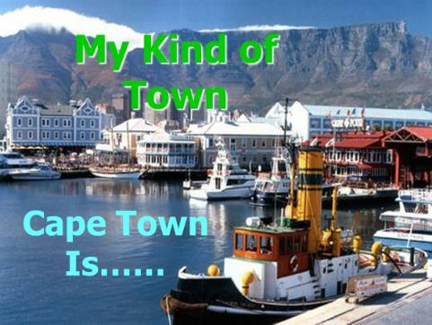
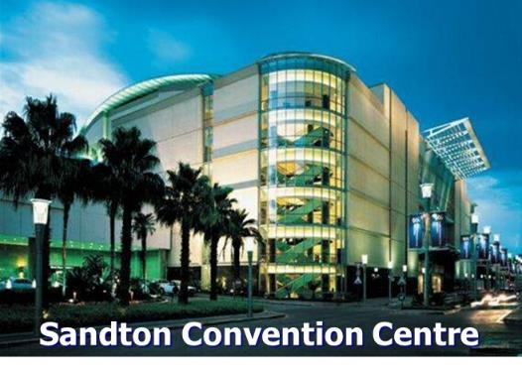
Fabulous Places
Notes:
South Africa (HDI Rank: 120): A Golden Opportunity – A Major Challenge
South Africa’s unique strengths:
The “Cradle” of humankind (Sterkfontein), and Modern Humans (Kalahari);
A Microcosm of a multi-ethnic multi-cultural “colourful” world that finds strength in cultural diversity;
A nation rich in historical experience - a disastrous human history presenting a powerful messages for the future;
A land rich in natural resources – human and other;
A significant “First Economy” that can contribute to “Second Economy” development – if allowed to, and encouraged to do so.
South Africa’s risks:
Failure to raise the national level of human development;
The consequential response of the massive “Second Economy” to its “exclusion” from “First Economy” advantages;
Failure to build the tools required for inclusive human development – affordable effective ICTs.
South Africa’s opportunity: Use the intellectual capacity of South Africa’s “First Economy” to build the ICT infrastructures that will address the knowledge access needs of South Africa’s “Second Economy” – true ICTs4D4ALL, addressing leading edge economic challenges, and developing country demands simultaneously, effectively.

Slide 4
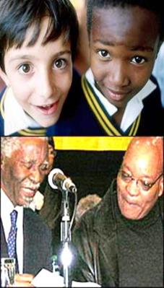
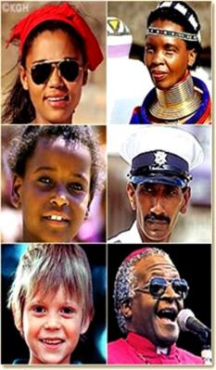
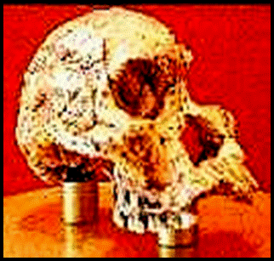
Fabulous People
Humankind’s First Lady
Mrs Ples from Sterkfontein
Notes:
South Africa (HDI Rank: 120): A Golden Opportunity – A Major Challenge
South Africa’s unique strengths:
The “Cradle” of humankind (Sterkfontein), and Modern Humans (Kalahari);
A Microcosm of a multi-ethnic multi-cultural “colourful” world that finds strength in cultural diversity;
A nation rich in historical experience - a disastrous human history presenting a powerful messages for the future;
A land rich in natural resources – human and other;
A significant “First Economy” that can contribute to “Second Economy” development – if allowed to, and encouraged to do so.
South Africa’s risks:
Failure to raise the national level of human development;
The consequential response of the massive “Second Economy” to its “exclusion” from “First Economy” advantages;
Failure to build the tools required for inclusive human development – affordable effective ICTs.
South Africa’s opportunity: Use the intellectual capacity of South Africa’s “First Economy” to build the ICT infrastructures that will address the knowledge access needs of South Africa’s “Second Economy” – true ICTs4D4ALL, addressing leading edge economic challenges, and developing country demands simultaneously, effectively.

Slide 5
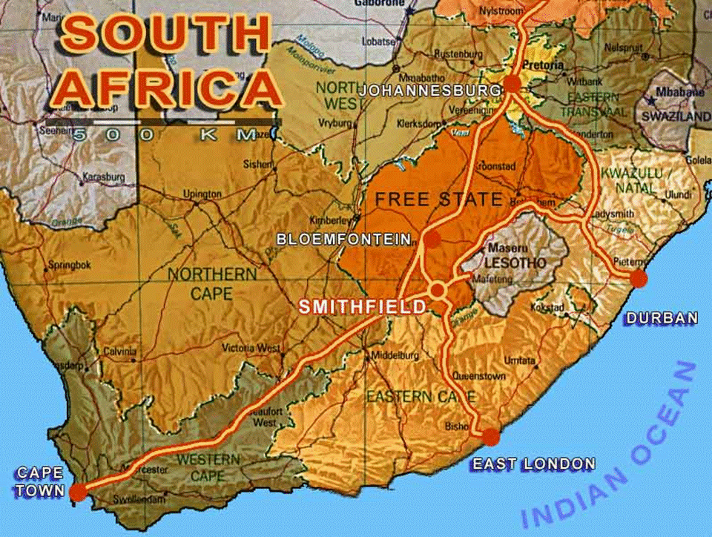
Hiding an Uncertain Future
Notes:
South Africa (HDI Rank: 120): A Golden Opportunity – A Major Challenge
South Africa’s unique strengths:
The “Cradle” of humankind (Sterkfontein), and Modern Humans (Kalahari);
A Microcosm of a multi-ethnic multi-cultural “colourful” world that finds strength in cultural diversity;
A nation rich in historical experience - a disastrous human history presenting a powerful messages for the future;
A land rich in natural resources – human and other;
A significant “First Economy” that can contribute to “Second Economy” development – if allowed to, and encouraged to do so.
South Africa’s risks:
Failure to raise the national level of human development;
The consequential response of the massive “Second Economy” to its “exclusion” from “First Economy” advantages;
Failure to build the tools required for inclusive human development – affordable effective ICTs.
South Africa’s opportunity: Use the intellectual capacity of South Africa’s “First Economy” to build the ICT infrastructures that will address the knowledge access needs of South Africa’s “Second Economy” – true ICTs4D4ALL, addressing leading edge economic challenges, and developing country demands simultaneously, effectively.

Slide 6
Of Extreme Inequality
Highest Urban Inequality in the World: Johannesburg GINI Coefficient – 0.74 (Alarm level = 0.4 – UN Habitat 2010)
63% South African Children live below poverty line (even after social grants: South African Child Gauge 2016)
Poverty undermines people’s dignity, compromises children’s survival, growth, education and employment chances
Threatens National Economic Growth and Socio-political Stability
Children and Youth are both VICTIMS, and the FUTURE
South Africa’s Future is in the hands of Today’s Children and Youth: They are Tomorrow’s Leaders and Decision-makers
Notes:
South Africa (HDI Rank: 120): A Golden Opportunity – A Major Challenge
South Africa’s unique strengths:
The “Cradle” of humankind (Sterkfontein), and Modern Humans (Kalahari);
A Microcosm of a multi-ethnic multi-cultural “colourful” world that finds strength in cultural diversity;
A nation rich in historical experience - a disastrous human history presenting a powerful messages for the future;
A land rich in natural resources – human and other;
A significant “First Economy” that can contribute to “Second Economy” development – if allowed to, and encouraged to do so.
South Africa’s risks:
Failure to raise the national level of human development;
The consequential response of the massive “Second Economy” to its “exclusion” from “First Economy” advantages;
Failure to build the tools required for inclusive human development – affordable effective ICTs.
South Africa’s opportunity: Use the intellectual capacity of South Africa’s “First Economy” to build the ICT infrastructures that will address the knowledge access needs of South Africa’s “Second Economy” – true ICTs4D4ALL, addressing leading edge economic challenges, and developing country demands simultaneously, effectively.

Slide 7
Inequality in Numbers (1)
Slide created by author in 2010 from UN Habitat Report 2010/2011
Notes:
South Africa (HDI Rank: 120): A Golden Opportunity – A Major Challenge
South Africa’s unique strengths:
The “Cradle” of humankind (Sterkfontein), and Modern Humans (Kalahari);
A Microcosm of a multi-ethnic multi-cultural “colourful” world that finds strength in cultural diversity;
A nation rich in historical experience - a disastrous human history presenting a powerful messages for the future;
A land rich in natural resources – human and other;
A significant “First Economy” that can contribute to “Second Economy” development – if allowed to, and encouraged to do so.
South Africa’s risks:
Failure to raise the national level of human development;
The consequential response of the massive “Second Economy” to its “exclusion” from “First Economy” advantages;
Failure to build the tools required for inclusive human development – affordable effective ICTs.
South Africa’s opportunity: Use the intellectual capacity of South Africa’s “First Economy” to build the ICT infrastructures that will address the knowledge access needs of South Africa’s “Second Economy” – true ICTs4D4ALL, addressing leading edge economic challenges, and developing country demands simultaneously, effectively.

Slide 8
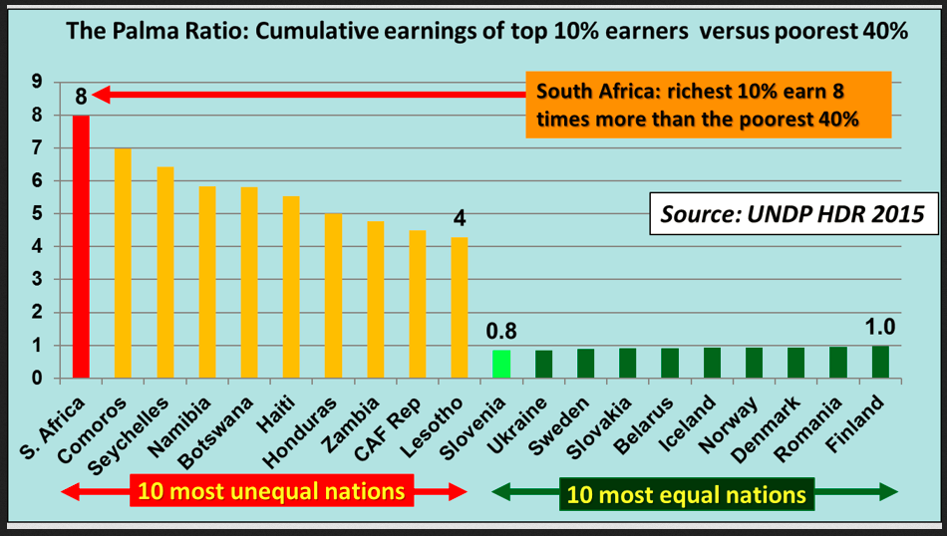
Inequality in Numbers (2)
Slide created by author in 2016 from UN Human Development Report 2015
Notes:
South Africa (HDI Rank: 120): A Golden Opportunity – A Major Challenge
South Africa’s unique strengths:
The “Cradle” of humankind (Sterkfontein), and Modern Humans (Kalahari);
A Microcosm of a multi-ethnic multi-cultural “colourful” world that finds strength in cultural diversity;
A nation rich in historical experience - a disastrous human history presenting a powerful messages for the future;
A land rich in natural resources – human and other;
A significant “First Economy” that can contribute to “Second Economy” development – if allowed to, and encouraged to do so.
South Africa’s risks:
Failure to raise the national level of human development;
The consequential response of the massive “Second Economy” to its “exclusion” from “First Economy” advantages;
Failure to build the tools required for inclusive human development – affordable effective ICTs.
South Africa’s opportunity: Use the intellectual capacity of South Africa’s “First Economy” to build the ICT infrastructures that will address the knowledge access needs of South Africa’s “Second Economy” – true ICTs4D4ALL, addressing leading edge economic challenges, and developing country demands simultaneously, effectively.

Slide 9
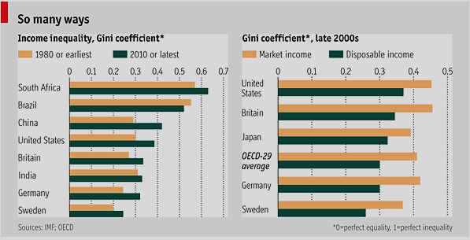
Inequality in Numbers (3)
Source: The Economist 2012: For richer, for poorer: http://www.economist.com/node/21564414
Notes:
South Africa (HDI Rank: 120): A Golden Opportunity – A Major Challenge
South Africa’s unique strengths:
The “Cradle” of humankind (Sterkfontein), and Modern Humans (Kalahari);
A Microcosm of a multi-ethnic multi-cultural “colourful” world that finds strength in cultural diversity;
A nation rich in historical experience - a disastrous human history presenting a powerful messages for the future;
A land rich in natural resources – human and other;
A significant “First Economy” that can contribute to “Second Economy” development – if allowed to, and encouraged to do so.
South Africa’s risks:
Failure to raise the national level of human development;
The consequential response of the massive “Second Economy” to its “exclusion” from “First Economy” advantages;
Failure to build the tools required for inclusive human development – affordable effective ICTs.
South Africa’s opportunity: Use the intellectual capacity of South Africa’s “First Economy” to build the ICT infrastructures that will address the knowledge access needs of South Africa’s “Second Economy” – true ICTs4D4ALL, addressing leading edge economic challenges, and developing country demands simultaneously, effectively.

Slide 10
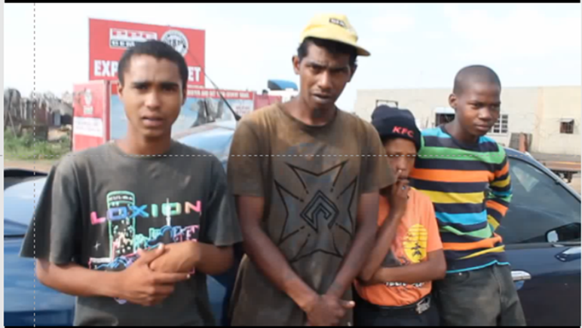
Nyaope addicts talk about their painful experiences
Please pause here and view the 1.5 minute video via the link below
https://www.youtube.com/watch?v=o7lTdTWHv_8
Notes:
South Africa (HDI Rank: 120): A Golden Opportunity – A Major Challenge
South Africa’s unique strengths:
The “Cradle” of humankind (Sterkfontein), and Modern Humans (Kalahari);
A Microcosm of a multi-ethnic multi-cultural “colourful” world that finds strength in cultural diversity;
A nation rich in historical experience - a disastrous human history presenting a powerful messages for the future;
A land rich in natural resources – human and other;
A significant “First Economy” that can contribute to “Second Economy” development – if allowed to, and encouraged to do so.
South Africa’s risks:
Failure to raise the national level of human development;
The consequential response of the massive “Second Economy” to its “exclusion” from “First Economy” advantages;
Failure to build the tools required for inclusive human development – affordable effective ICTs.
South Africa’s opportunity: Use the intellectual capacity of South Africa’s “First Economy” to build the ICT infrastructures that will address the knowledge access needs of South Africa’s “Second Economy” – true ICTs4D4ALL, addressing leading edge economic challenges, and developing country demands simultaneously, effectively.

Slide 11
Providing Access to Information and Knowledge for Children, Youth and Communities to:
Create “safe Community Hangouts” for peer group inclusion
Develop alternative Lifestyle Choices – Drugs and Crime
Access Information and Knowledge for:
Health and Safety
Self and Peer-group Learning
Entrepreneurship and Job Creation
Crime Prevention and Citizen Development
Affordable Technological Assimilation and Use
A vast Human Laboratory, challenging Inequality, Poverty and Exclusion from within, absorbing externalities at their own pace
Notes:
South Africa (HDI Rank: 120): A Golden Opportunity – A Major Challenge
South Africa’s unique strengths:
The “Cradle” of humankind (Sterkfontein), and Modern Humans (Kalahari);
A Microcosm of a multi-ethnic multi-cultural “colourful” world that finds strength in cultural diversity;
A nation rich in historical experience - a disastrous human history presenting a powerful messages for the future;
A land rich in natural resources – human and other;
A significant “First Economy” that can contribute to “Second Economy” development – if allowed to, and encouraged to do so.
South Africa’s risks:
Failure to raise the national level of human development;
The consequential response of the massive “Second Economy” to its “exclusion” from “First Economy” advantages;
Failure to build the tools required for inclusive human development – affordable effective ICTs.
South Africa’s opportunity: Use the intellectual capacity of South Africa’s “First Economy” to build the ICT infrastructures that will address the knowledge access needs of South Africa’s “Second Economy” – true ICTs4D4ALL, addressing leading edge economic challenges, and developing country demands simultaneously, effectively.

Slide 12
HOW?
Mass rollout of LAN Houses – Internet Cafés with a Difference;
Owned and Operated by Local Youth as SMMEs
Providing safe venues for peer group inclusive learning
Providing a wide range of Services to local communities
Reverse anti-social lifestyles through peer-group choice
Simple, tried and tested technologies, very low comparative costs
Primary target Marginalized and Unemployed Youth
Notes:
South Africa (HDI Rank: 120): A Golden Opportunity – A Major Challenge
South Africa’s unique strengths:
The “Cradle” of humankind (Sterkfontein), and Modern Humans (Kalahari);
A Microcosm of a multi-ethnic multi-cultural “colourful” world that finds strength in cultural diversity;
A nation rich in historical experience - a disastrous human history presenting a powerful messages for the future;
A land rich in natural resources – human and other;
A significant “First Economy” that can contribute to “Second Economy” development – if allowed to, and encouraged to do so.
South Africa’s risks:
Failure to raise the national level of human development;
The consequential response of the massive “Second Economy” to its “exclusion” from “First Economy” advantages;
Failure to build the tools required for inclusive human development – affordable effective ICTs.
South Africa’s opportunity: Use the intellectual capacity of South Africa’s “First Economy” to build the ICT infrastructures that will address the knowledge access needs of South Africa’s “Second Economy” – true ICTs4D4ALL, addressing leading edge economic challenges, and developing country demands simultaneously, effectively.

Slide 13
WHAT ARE LAN HOUSES?
Community-based “Infotainment” access points with focus on youth
Owned and Operated by Local Youth as SMMEs, access and user prices commensurate with affordability in the community – affordable private internet cafés…
Much more than “internet cafés” or technology access centres – they are “safe hangouts” where young and old gather to communicate, learn and play…….
They are highly scalable – safety and security by numbers
Prolific job creators as SMME information service providers and platforms for SMME businesses – productive revenue-generating use of information and knowledge
Capital and operating costs kept very low for “massification” and sustainability
Notes:
South Africa (HDI Rank: 120): A Golden Opportunity – A Major Challenge
South Africa’s unique strengths:
The “Cradle” of humankind (Sterkfontein), and Modern Humans (Kalahari);
A Microcosm of a multi-ethnic multi-cultural “colourful” world that finds strength in cultural diversity;
A nation rich in historical experience - a disastrous human history presenting a powerful messages for the future;
A land rich in natural resources – human and other;
A significant “First Economy” that can contribute to “Second Economy” development – if allowed to, and encouraged to do so.
South Africa’s risks:
Failure to raise the national level of human development;
The consequential response of the massive “Second Economy” to its “exclusion” from “First Economy” advantages;
Failure to build the tools required for inclusive human development – affordable effective ICTs.
South Africa’s opportunity: Use the intellectual capacity of South Africa’s “First Economy” to build the ICT infrastructures that will address the knowledge access needs of South Africa’s “Second Economy” – true ICTs4D4ALL, addressing leading edge economic challenges, and developing country demands simultaneously, effectively.

Slide 14
WHAT CAN THEY DO?
Provide the foundations for technological appropriation for socioeconomically marginalized youth and adult communities
Learn and Play through entertainment and learning-focussed online games – A distraction from drugs and crime….
Community technological support services including access to affordable broadband for laptop, smartphones and tablets: Become community-based ICT maintenance and repair centres
Self-learning through peer group inclusive interactions
Complement basic, vocational and high-level public education systems – affordable access to high-volume learning content
Affordable individual and community access to all developmental information and knowledge sources: e-Governance; e-Commerce; e-Learning; e-Security; e-Safety; e-Health; e-Community
National-scale laboratories for Academic and Applied R&D: “Bottom-up” innovations to defeat inequality, poverty and socioeconomic exclusion
Notes:
South Africa (HDI Rank: 120): A Golden Opportunity – A Major Challenge
South Africa’s unique strengths:
The “Cradle” of humankind (Sterkfontein), and Modern Humans (Kalahari);
A Microcosm of a multi-ethnic multi-cultural “colourful” world that finds strength in cultural diversity;
A nation rich in historical experience - a disastrous human history presenting a powerful messages for the future;
A land rich in natural resources – human and other;
A significant “First Economy” that can contribute to “Second Economy” development – if allowed to, and encouraged to do so.
South Africa’s risks:
Failure to raise the national level of human development;
The consequential response of the massive “Second Economy” to its “exclusion” from “First Economy” advantages;
Failure to build the tools required for inclusive human development – affordable effective ICTs.
South Africa’s opportunity: Use the intellectual capacity of South Africa’s “First Economy” to build the ICT infrastructures that will address the knowledge access needs of South Africa’s “Second Economy” – true ICTs4D4ALL, addressing leading edge economic challenges, and developing country demands simultaneously, effectively.

Slide 15
WHAT THEY ARE NOT
LAN Houses are NOT formalized learning or tuition centres – these services are provided by the formal school system and national networks of “innovation hubs”, “Cyber-labs”, etc.
LAN Houses are NOT public or private development service provider centres – they are private commercial SMME businesses owned and operated by individuals and/or groups residing in socioeconomically marginalized communities
LAN Houses are NOT restricted to ICT service provider businesses – they are flexible, expandable to ICT user-focussed businesses
LAN Houses are NOT just entertainment centres where youth play games: e-games and e-sport as earning opportunities and learning tools; entertainment for community cohesion and distraction from social deviances like crime and drugs; e-entertainment as a commercial business opportunity
LAN Houses CAN be all the things they are not – the choices lie with their owners, community and development partners
Notes:
South Africa (HDI Rank: 120): A Golden Opportunity – A Major Challenge
South Africa’s unique strengths:
The “Cradle” of humankind (Sterkfontein), and Modern Humans (Kalahari);
A Microcosm of a multi-ethnic multi-cultural “colourful” world that finds strength in cultural diversity;
A nation rich in historical experience - a disastrous human history presenting a powerful messages for the future;
A land rich in natural resources – human and other;
A significant “First Economy” that can contribute to “Second Economy” development – if allowed to, and encouraged to do so.
South Africa’s risks:
Failure to raise the national level of human development;
The consequential response of the massive “Second Economy” to its “exclusion” from “First Economy” advantages;
Failure to build the tools required for inclusive human development – affordable effective ICTs.
South Africa’s opportunity: Use the intellectual capacity of South Africa’s “First Economy” to build the ICT infrastructures that will address the knowledge access needs of South Africa’s “Second Economy” – true ICTs4D4ALL, addressing leading edge economic challenges, and developing country demands simultaneously, effectively.

Slide 16
WHAT THEY CAN BECOME
Click anywhere in JR’s photo to see and hear his artistic talent
A platform for the creation of South Africa’s significant artistic talent – streamed to a global audience and market
Can the success of a solo artist streaming his music to a highly appreciative international audience and market like this exceptional example by #stilljreming be emulated in South African LAN Houses located in South Africa’s sprawling “Informal” and other poor residential areas? Please click the picture to hear JR’s rendition of “Hard Time Killing Floor Blues” A musical story that harmonizes closely with South Africa’s poor………….
Notes:
South Africa (HDI Rank: 120): A Golden Opportunity – A Major Challenge
South Africa’s unique strengths:
The “Cradle” of humankind (Sterkfontein), and Modern Humans (Kalahari);
A Microcosm of a multi-ethnic multi-cultural “colourful” world that finds strength in cultural diversity;
A nation rich in historical experience - a disastrous human history presenting a powerful messages for the future;
A land rich in natural resources – human and other;
A significant “First Economy” that can contribute to “Second Economy” development – if allowed to, and encouraged to do so.
South Africa’s risks:
Failure to raise the national level of human development;
The consequential response of the massive “Second Economy” to its “exclusion” from “First Economy” advantages;
Failure to build the tools required for inclusive human development – affordable effective ICTs.
South Africa’s opportunity: Use the intellectual capacity of South Africa’s “First Economy” to build the ICT infrastructures that will address the knowledge access needs of South Africa’s “Second Economy” – true ICTs4D4ALL, addressing leading edge economic challenges, and developing country demands simultaneously, effectively.

Slide 17
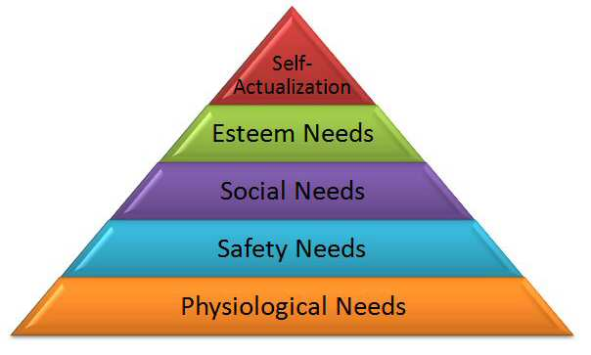
Two Theoretical Foundations
The Hawthorn Studies: Elton Mayo 1920/30
Aim: How to motivate factory workers for higher productivity
Key Findings: The attention given to the workforce, their participation in the processes, is a far greater motivator than improvements in the work environment
See http://www.economist.com/node/12510632 for recent introduction
Maslow’s Hierarchy of Needs: 1943
Influential Anthropological study of Human Behaviour
Basic Human Needs expressed in a Hierarchy
Satisfying one set of needs leads to aspiration for next level
What a man/woman can be, he/she must be, or else despondency leading to rebellion may follow. Intro: http://www.economist.com/node/12407919
What can we learn from these 70+ year-old theories to help pull 63% of South Africa’s youth from the hopelessness of Inequality, Poverty and Exclusion? What role of Information and Knowledge via ICT?
Notes:
South Africa (HDI Rank: 120): A Golden Opportunity – A Major Challenge
South Africa’s unique strengths:
The “Cradle” of humankind (Sterkfontein), and Modern Humans (Kalahari);
A Microcosm of a multi-ethnic multi-cultural “colourful” world that finds strength in cultural diversity;
A nation rich in historical experience - a disastrous human history presenting a powerful messages for the future;
A land rich in natural resources – human and other;
A significant “First Economy” that can contribute to “Second Economy” development – if allowed to, and encouraged to do so.
South Africa’s risks:
Failure to raise the national level of human development;
The consequential response of the massive “Second Economy” to its “exclusion” from “First Economy” advantages;
Failure to build the tools required for inclusive human development – affordable effective ICTs.
South Africa’s opportunity: Use the intellectual capacity of South Africa’s “First Economy” to build the ICT infrastructures that will address the knowledge access needs of South Africa’s “Second Economy” – true ICTs4D4ALL, addressing leading edge economic challenges, and developing country demands simultaneously, effectively.

Slide 18
Maslow’s Hierarchy of Needs
Applied to the Base of the Development Pyramid
Help
Others
Climb the
Hierarchy
Driving
Growth
For All
Transcendence
TRANSCENDENCE: The Self-Actualized help others to Self-Actualize
Very rare amongst individuals and Corporates
Progressive States assume responsibility: Mass Education; Health
& Well-being; Economic Growth through Rewarding Jobs
Failure leads to Stagnation, Civil Decay, and Worse
Self-Actualization
Personal Aspirations Met
The Wealthy Zone; Home of the Richest 1%; Mainly Senior Citizens
Contributes to Economy via e.g. Taxes: Some Philanthropic Work & CSR
Main growth driver for lower ranks: Anger if path to higher rank is impeded
Aesthetic
Art, Culture, Fashion,
Three-tier Middle Income Socioeconomic Zone
Greatest Opportunity for Rapid National Economic Growth
Cognitive
Knowledge/Creativity
Through SMME Entrepreneurship, Innovation, Professionalism
Demanding Affordable Access to Information, Knowledge, Services
Esteem
Status, Respect, Reputation
Social Strife if Opportunities/Resources don’t match Aspirations
Progress Frustrated by Opportunity, Resource. Income Limitations
And by Responsibility for Lower Rank Extended Families
Belonging, Social Inclusion
Family and Community Stability/Support
Non-poor Non-rich Lowest Income Zone
Low educational achievement, un-skilled work
Birth of Ambition, Opportunity, Hope
Safety, Security
Exclusion & Poverty breed crime, stunts growth
The “Dawn” of cognitive humanity
Recognition of the possibility of a “better” life
Strive for a “better” life, by fair means or foul
Basic Biological, Physiological Needs
63% of South Africa’s Children living in this zone?
Lowest Socio/Political/Economic Zone
Home to 63% of South Africa’s Children?
Too few avenues for escape

Slide 19
A Short Survey of the World’s Internet Cafés
BRICS community and others
Notes:
South Africa (HDI Rank: 120): A Golden Opportunity – A Major Challenge
South Africa’s unique strengths:
The “Cradle” of humankind (Sterkfontein), and Modern Humans (Kalahari);
A Microcosm of a multi-ethnic multi-cultural “colourful” world that finds strength in cultural diversity;
A nation rich in historical experience - a disastrous human history presenting a powerful messages for the future;
A land rich in natural resources – human and other;
A significant “First Economy” that can contribute to “Second Economy” development – if allowed to, and encouraged to do so.
South Africa’s risks:
Failure to raise the national level of human development;
The consequential response of the massive “Second Economy” to its “exclusion” from “First Economy” advantages;
Failure to build the tools required for inclusive human development – affordable effective ICTs.
South Africa’s opportunity: Use the intellectual capacity of South Africa’s “First Economy” to build the ICT infrastructures that will address the knowledge access needs of South Africa’s “Second Economy” – true ICTs4D4ALL, addressing leading edge economic challenges, and developing country demands simultaneously, effectively.

Slide 20
MINISTÉRIO DO PLANEJAMENTO
Lan Houses Phenomena
Lan House is a commercial business similar to a cyber café, where people can pay to use a computer to access internet or a Local Area Network, to access fast information in the Web and entertainment with network games or online.
According to Internet Management Committee in Brazil, CGI.br, 47% of the urban population accessed the Internet in a Lan House. In the rural area the number reaches 58% -- the majority are male, classes C, D and E.
90 thousand Lan Houses in Brazil
Lan Houses are the big Digital Inclusion engine in Brazil, involving 2/3 of the young internet users.
The number of internet users in Lan Houses doubled in the last year, reaching 25 million people.
82% are workers receiving the minimum wage
Brazil
http://www.sakan.org.za/Docs/MultiStakeholder_Forum.ppt
Introduced by Brazilian Delegation during State Visit of February 2010
Government collects donated second-hand PCs, stores & reconditions them;
Recruits youth in Favela’s and trains them in refurbishment and use
Sets up LAN houses in favelas, owned by trained youth
Youth purchase PCs and networking equipment on 5-year repayment plans;
Youth operate LAN Houses as private businesses
Demand is very high – young people play and learn in LAN Houses
Notes:
South Africa (HDI Rank: 120): A Golden Opportunity – A Major Challenge
South Africa’s unique strengths:
The “Cradle” of humankind (Sterkfontein), and Modern Humans (Kalahari);
A Microcosm of a multi-ethnic multi-cultural “colourful” world that finds strength in cultural diversity;
A nation rich in historical experience - a disastrous human history presenting a powerful messages for the future;
A land rich in natural resources – human and other;
A significant “First Economy” that can contribute to “Second Economy” development – if allowed to, and encouraged to do so.
South Africa’s risks:
Failure to raise the national level of human development;
The consequential response of the massive “Second Economy” to its “exclusion” from “First Economy” advantages;
Failure to build the tools required for inclusive human development – affordable effective ICTs.
South Africa’s opportunity: Use the intellectual capacity of South Africa’s “First Economy” to build the ICT infrastructures that will address the knowledge access needs of South Africa’s “Second Economy” – true ICTs4D4ALL, addressing leading edge economic challenges, and developing country demands simultaneously, effectively.

Slide 21
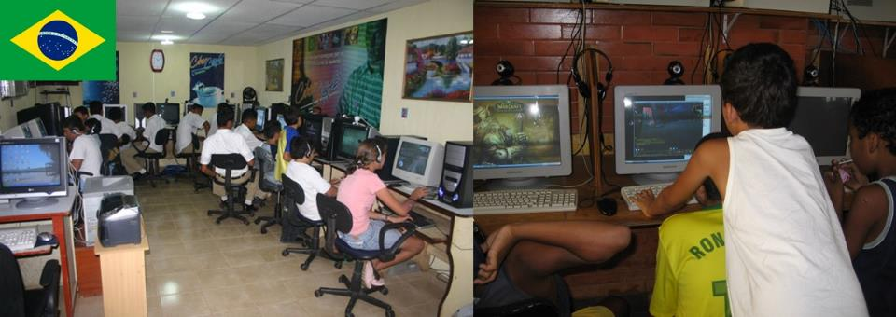
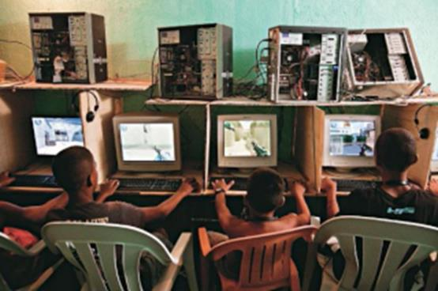
Brazil
Over 100,000 LAN Houses in Brazil’s favelas
Drove internet users to more than 71% amongst poor
Compliments School System
Safe hangout for youth, Valued by adults
Notes:
South Africa (HDI Rank: 120): A Golden Opportunity – A Major Challenge
South Africa’s unique strengths:
The “Cradle” of humankind (Sterkfontein), and Modern Humans (Kalahari);
A Microcosm of a multi-ethnic multi-cultural “colourful” world that finds strength in cultural diversity;
A nation rich in historical experience - a disastrous human history presenting a powerful messages for the future;
A land rich in natural resources – human and other;
A significant “First Economy” that can contribute to “Second Economy” development – if allowed to, and encouraged to do so.
South Africa’s risks:
Failure to raise the national level of human development;
The consequential response of the massive “Second Economy” to its “exclusion” from “First Economy” advantages;
Failure to build the tools required for inclusive human development – affordable effective ICTs.
South Africa’s opportunity: Use the intellectual capacity of South Africa’s “First Economy” to build the ICT infrastructures that will address the knowledge access needs of South Africa’s “Second Economy” – true ICTs4D4ALL, addressing leading edge economic challenges, and developing country demands simultaneously, effectively.

Slide 22
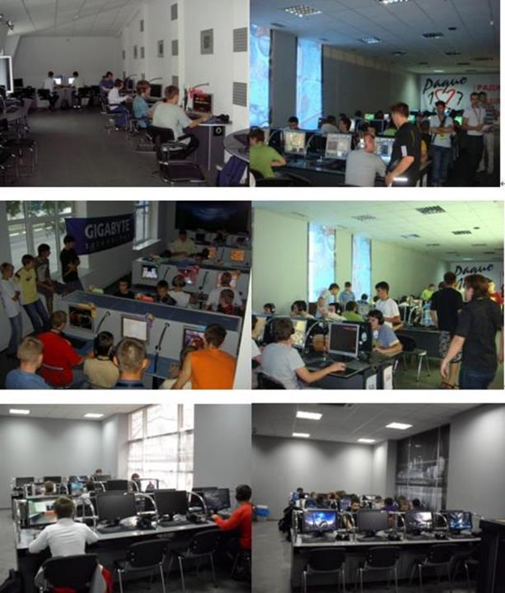
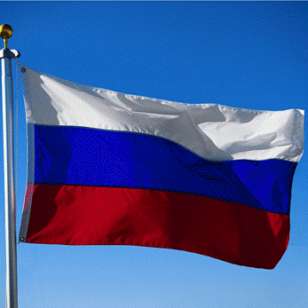
Russia
All sites interconnected at 100 Mb/s
Each has minimum 10 Mb/s connection
Games, Study, Entertainment, Surfing, e-Governance services
Minimum State Control
Notes:
South Africa (HDI Rank: 120): A Golden Opportunity – A Major Challenge
South Africa’s unique strengths:
The “Cradle” of humankind (Sterkfontein), and Modern Humans (Kalahari);
A Microcosm of a multi-ethnic multi-cultural “colourful” world that finds strength in cultural diversity;
A nation rich in historical experience - a disastrous human history presenting a powerful messages for the future;
A land rich in natural resources – human and other;
A significant “First Economy” that can contribute to “Second Economy” development – if allowed to, and encouraged to do so.
South Africa’s risks:
Failure to raise the national level of human development;
The consequential response of the massive “Second Economy” to its “exclusion” from “First Economy” advantages;
Failure to build the tools required for inclusive human development – affordable effective ICTs.
South Africa’s opportunity: Use the intellectual capacity of South Africa’s “First Economy” to build the ICT infrastructures that will address the knowledge access needs of South Africa’s “Second Economy” – true ICTs4D4ALL, addressing leading edge economic challenges, and developing country demands simultaneously, effectively.

Slide 23
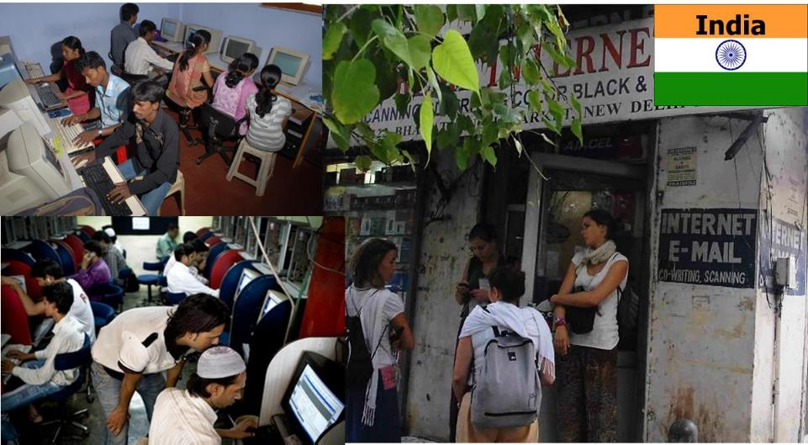
Vital access for unconnected masses;
Major access points for large numbers of rural village dwellers
Broadband connections via National Knowledge Network of India (NKN)
Fuels India’s Economic Growth rate of more than 7% pa.
Notes:
South Africa (HDI Rank: 120): A Golden Opportunity – A Major Challenge
South Africa’s unique strengths:
The “Cradle” of humankind (Sterkfontein), and Modern Humans (Kalahari);
A Microcosm of a multi-ethnic multi-cultural “colourful” world that finds strength in cultural diversity;
A nation rich in historical experience - a disastrous human history presenting a powerful messages for the future;
A land rich in natural resources – human and other;
A significant “First Economy” that can contribute to “Second Economy” development – if allowed to, and encouraged to do so.
South Africa’s risks:
Failure to raise the national level of human development;
The consequential response of the massive “Second Economy” to its “exclusion” from “First Economy” advantages;
Failure to build the tools required for inclusive human development – affordable effective ICTs.
South Africa’s opportunity: Use the intellectual capacity of South Africa’s “First Economy” to build the ICT infrastructures that will address the knowledge access needs of South Africa’s “Second Economy” – true ICTs4D4ALL, addressing leading edge economic challenges, and developing country demands simultaneously, effectively.

Slide 24
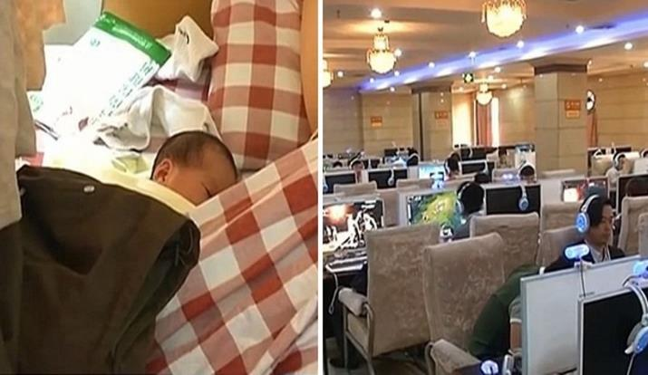
Baby Born in Internet Cafe
14,000+ “Legal” Internet Cafés;
More than 28,000 informal ones
Gaming very popular entertainment
Education and e-Commerce trading
Major driver of ICT User density and Economic Growth
Notes:
South Africa (HDI Rank: 120): A Golden Opportunity – A Major Challenge
South Africa’s unique strengths:
The “Cradle” of humankind (Sterkfontein), and Modern Humans (Kalahari);
A Microcosm of a multi-ethnic multi-cultural “colourful” world that finds strength in cultural diversity;
A nation rich in historical experience - a disastrous human history presenting a powerful messages for the future;
A land rich in natural resources – human and other;
A significant “First Economy” that can contribute to “Second Economy” development – if allowed to, and encouraged to do so.
South Africa’s risks:
Failure to raise the national level of human development;
The consequential response of the massive “Second Economy” to its “exclusion” from “First Economy” advantages;
Failure to build the tools required for inclusive human development – affordable effective ICTs.
South Africa’s opportunity: Use the intellectual capacity of South Africa’s “First Economy” to build the ICT infrastructures that will address the knowledge access needs of South Africa’s “Second Economy” – true ICTs4D4ALL, addressing leading edge economic challenges, and developing country demands simultaneously, effectively.

Slide 25
An Online
Market in China
New York Times,
9th August 2009
China E-Commerce Case Study
23 year old Yang Fugang, college student from poor family, used the e-Commerce platform Taobao.com to establish a Micro-business;
Market entry selling Yoga mats, expanded to cosmetics, perfumes, and other luxury goods;
Began trading from an Internet Café at US$ 10 per month, now has his own access terminals and broadband connection
Generated an income of US$75,000 the previous year, 12 times the national GNI per Capita;
Employs 14 other youngsters, operates from 2 warehouses;
Mr. Yang started a revolution at his school - “Taobao.com Fever” - thousands of students run SMME businesses from their dormitories……..
Notes:
South Africa (HDI Rank: 120): A Golden Opportunity – A Major Challenge
South Africa’s unique strengths:
The “Cradle” of humankind (Sterkfontein), and Modern Humans (Kalahari);
A Microcosm of a multi-ethnic multi-cultural “colourful” world that finds strength in cultural diversity;
A nation rich in historical experience - a disastrous human history presenting a powerful messages for the future;
A land rich in natural resources – human and other;
A significant “First Economy” that can contribute to “Second Economy” development – if allowed to, and encouraged to do so.
South Africa’s risks:
Failure to raise the national level of human development;
The consequential response of the massive “Second Economy” to its “exclusion” from “First Economy” advantages;
Failure to build the tools required for inclusive human development – affordable effective ICTs.
South Africa’s opportunity: Use the intellectual capacity of South Africa’s “First Economy” to build the ICT infrastructures that will address the knowledge access needs of South Africa’s “Second Economy” – true ICTs4D4ALL, addressing leading edge economic challenges, and developing country demands simultaneously, effectively.

Slide 26
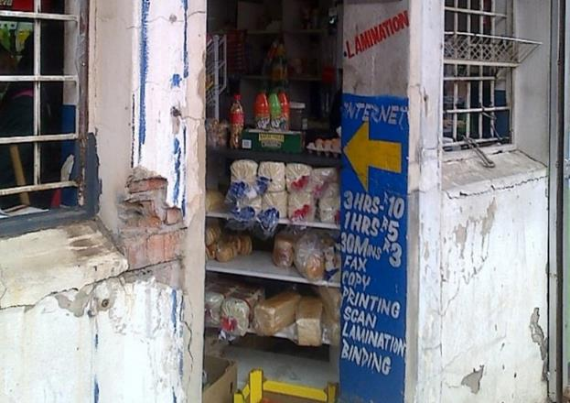
South
Africa
Immigrants offer Internet Café Services
Immigrants, mainly professionals from West Africa, are the few entrepreneurs willing to provide affordable internet café services
Local entrepreneurs find the cost of broadband too high, and the quality too low, to run viable businesses
Immigrants, often with other full time jobs, offer services from R3.00 per hour, compared to R60.00 per hour in most mid/high income areas
Read article HERE
Notes:
South Africa (HDI Rank: 120): A Golden Opportunity – A Major Challenge
South Africa’s unique strengths:
The “Cradle” of humankind (Sterkfontein), and Modern Humans (Kalahari);
A Microcosm of a multi-ethnic multi-cultural “colourful” world that finds strength in cultural diversity;
A nation rich in historical experience - a disastrous human history presenting a powerful messages for the future;
A land rich in natural resources – human and other;
A significant “First Economy” that can contribute to “Second Economy” development – if allowed to, and encouraged to do so.
South Africa’s risks:
Failure to raise the national level of human development;
The consequential response of the massive “Second Economy” to its “exclusion” from “First Economy” advantages;
Failure to build the tools required for inclusive human development – affordable effective ICTs.
South Africa’s opportunity: Use the intellectual capacity of South Africa’s “First Economy” to build the ICT infrastructures that will address the knowledge access needs of South Africa’s “Second Economy” – true ICTs4D4ALL, addressing leading edge economic challenges, and developing country demands simultaneously, effectively.

Slide 27
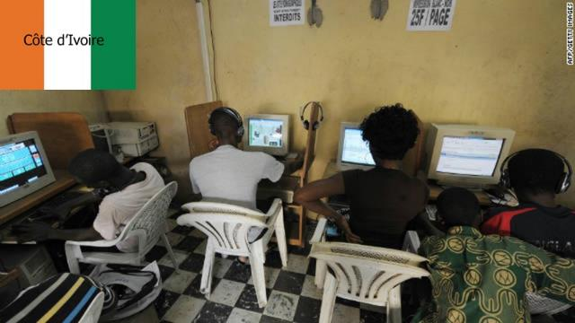
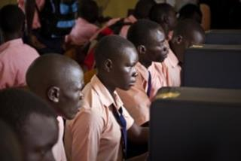
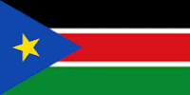
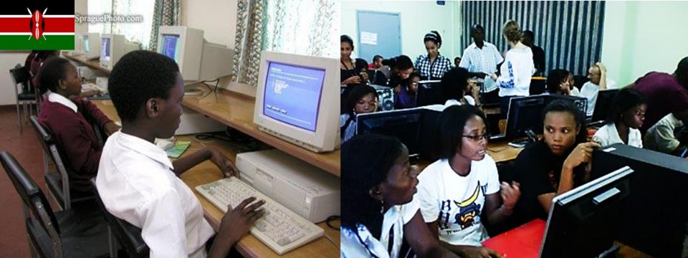
South Sudan
Kibagare Informal Settlement, Kenya
Beira, Mozambique
Notes:
South Africa (HDI Rank: 120): A Golden Opportunity – A Major Challenge
South Africa’s unique strengths:
The “Cradle” of humankind (Sterkfontein), and Modern Humans (Kalahari);
A Microcosm of a multi-ethnic multi-cultural “colourful” world that finds strength in cultural diversity;
A nation rich in historical experience - a disastrous human history presenting a powerful messages for the future;
A land rich in natural resources – human and other;
A significant “First Economy” that can contribute to “Second Economy” development – if allowed to, and encouraged to do so.
South Africa’s risks:
Failure to raise the national level of human development;
The consequential response of the massive “Second Economy” to its “exclusion” from “First Economy” advantages;
Failure to build the tools required for inclusive human development – affordable effective ICTs.
South Africa’s opportunity: Use the intellectual capacity of South Africa’s “First Economy” to build the ICT infrastructures that will address the knowledge access needs of South Africa’s “Second Economy” – true ICTs4D4ALL, addressing leading edge economic challenges, and developing country demands simultaneously, effectively.

Slide 28
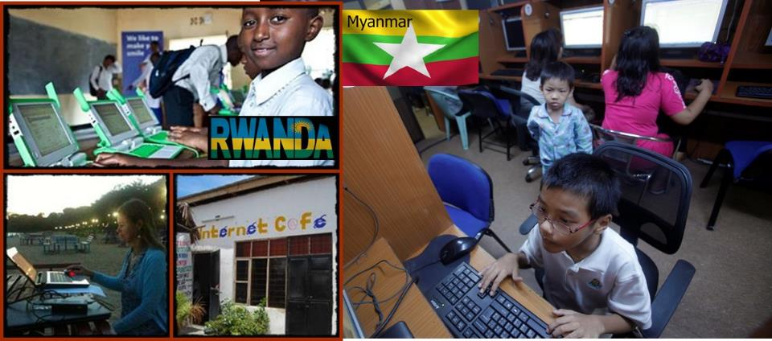
Notes:
South Africa (HDI Rank: 120): A Golden Opportunity – A Major Challenge
South Africa’s unique strengths:
The “Cradle” of humankind (Sterkfontein), and Modern Humans (Kalahari);
A Microcosm of a multi-ethnic multi-cultural “colourful” world that finds strength in cultural diversity;
A nation rich in historical experience - a disastrous human history presenting a powerful messages for the future;
A land rich in natural resources – human and other;
A significant “First Economy” that can contribute to “Second Economy” development – if allowed to, and encouraged to do so.
South Africa’s risks:
Failure to raise the national level of human development;
The consequential response of the massive “Second Economy” to its “exclusion” from “First Economy” advantages;
Failure to build the tools required for inclusive human development – affordable effective ICTs.
South Africa’s opportunity: Use the intellectual capacity of South Africa’s “First Economy” to build the ICT infrastructures that will address the knowledge access needs of South Africa’s “Second Economy” – true ICTs4D4ALL, addressing leading edge economic challenges, and developing country demands simultaneously, effectively.

Slide 29
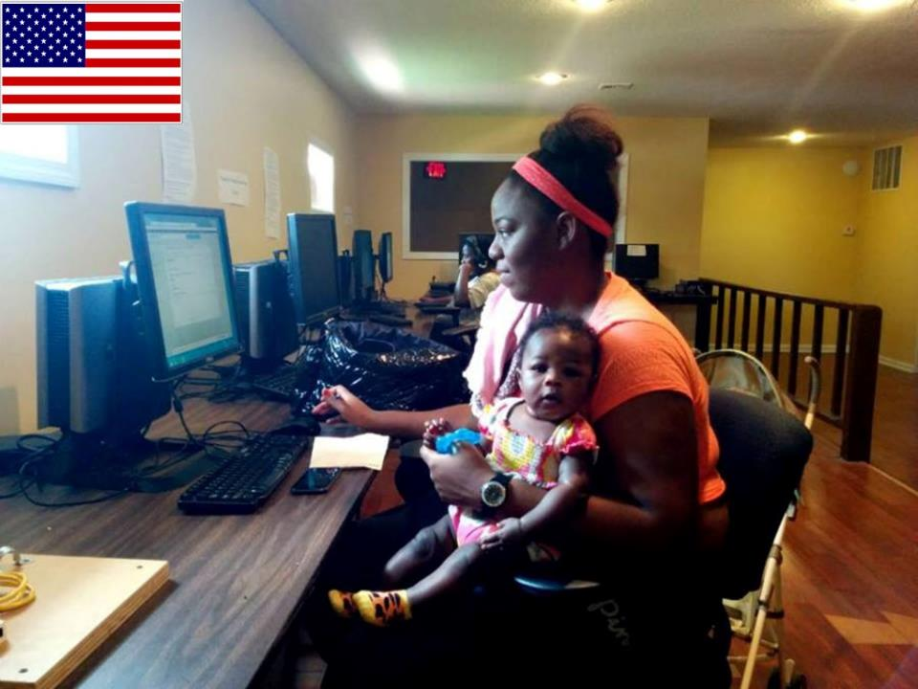
Kansas City, USA: Across the river from Google Fibre’s 1Gb/s network are very low income neighbourhoods. Non-profit Connecting For Good bridges the Kansas City Digital Divide. This single mother finds opportunities in the Internet Café……..
Notes:
South Africa (HDI Rank: 120): A Golden Opportunity – A Major Challenge
South Africa’s unique strengths:
The “Cradle” of humankind (Sterkfontein), and Modern Humans (Kalahari);
A Microcosm of a multi-ethnic multi-cultural “colourful” world that finds strength in cultural diversity;
A nation rich in historical experience - a disastrous human history presenting a powerful messages for the future;
A land rich in natural resources – human and other;
A significant “First Economy” that can contribute to “Second Economy” development – if allowed to, and encouraged to do so.
South Africa’s risks:
Failure to raise the national level of human development;
The consequential response of the massive “Second Economy” to its “exclusion” from “First Economy” advantages;
Failure to build the tools required for inclusive human development – affordable effective ICTs.
South Africa’s opportunity: Use the intellectual capacity of South Africa’s “First Economy” to build the ICT infrastructures that will address the knowledge access needs of South Africa’s “Second Economy” – true ICTs4D4ALL, addressing leading edge economic challenges, and developing country demands simultaneously, effectively.

Slide 30
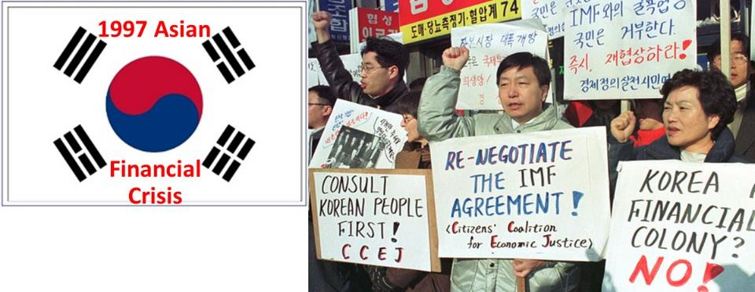
South Korea led the region out of the CRISIS…..
One of the recovery tools used was the ICT Sector:
Thousands of Internet Cafes set up in schools, Post Offices, etc., to teach new skills to women who had lost their jobs;
Men rioted – they wanted the same;
Some 10 million South Koreans retrained in these PC Bangs – Computer Rooms – They played Computer Games to learn fast
2014: 82% households have average 2 PCs + multiple smartphones; >12,000 public PC Bangs; S. Korea world broadband leader
What lessons can South Africa Draw from this?
Notes:
South Africa (HDI Rank: 120): A Golden Opportunity – A Major Challenge
South Africa’s unique strengths:
The “Cradle” of humankind (Sterkfontein), and Modern Humans (Kalahari);
A Microcosm of a multi-ethnic multi-cultural “colourful” world that finds strength in cultural diversity;
A nation rich in historical experience - a disastrous human history presenting a powerful messages for the future;
A land rich in natural resources – human and other;
A significant “First Economy” that can contribute to “Second Economy” development – if allowed to, and encouraged to do so.
South Africa’s risks:
Failure to raise the national level of human development;
The consequential response of the massive “Second Economy” to its “exclusion” from “First Economy” advantages;
Failure to build the tools required for inclusive human development – affordable effective ICTs.
South Africa’s opportunity: Use the intellectual capacity of South Africa’s “First Economy” to build the ICT infrastructures that will address the knowledge access needs of South Africa’s “Second Economy” – true ICTs4D4ALL, addressing leading edge economic challenges, and developing country demands simultaneously, effectively.

Slide 31
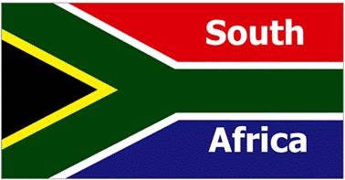
These Children need our support… and fast…..
The Consequences of doing nothing is too ghastly to contemplate…….
A Revolution that is already simmering..
#FeesMustFall; #DataMustFall; #WhatElseMustFall?
Progressive Social Delinquency and Crime
Massive drain and missed opportunity for National Economic Development
Failure is NOT an Option………
Notes:
South Africa (HDI Rank: 120): A Golden Opportunity – A Major Challenge
South Africa’s unique strengths:
The “Cradle” of humankind (Sterkfontein), and Modern Humans (Kalahari);
A Microcosm of a multi-ethnic multi-cultural “colourful” world that finds strength in cultural diversity;
A nation rich in historical experience - a disastrous human history presenting a powerful messages for the future;
A land rich in natural resources – human and other;
A significant “First Economy” that can contribute to “Second Economy” development – if allowed to, and encouraged to do so.
South Africa’s risks:
Failure to raise the national level of human development;
The consequential response of the massive “Second Economy” to its “exclusion” from “First Economy” advantages;
Failure to build the tools required for inclusive human development – affordable effective ICTs.
South Africa’s opportunity: Use the intellectual capacity of South Africa’s “First Economy” to build the ICT infrastructures that will address the knowledge access needs of South Africa’s “Second Economy” – true ICTs4D4ALL, addressing leading edge economic challenges, and developing country demands simultaneously, effectively.

Slide 32
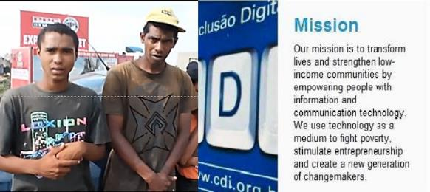
To Transform Lives
To Strengthen Low Income Communities
To use Technology to fight Inequality, Poverty and Exclusion of vast population segments from the fruits of Development
South Africa must
build Internet Cafés for the Young, Marginalized and Poor…..
The UN Recommendation to fix extreme inequalities
Recommended intervention Areas in Southern Africa
As part of development policies, public authorities must mobilise urban young peoples’ potentials and energies with proper training in entrepreneur skills and information/ communication technologies, in order to enable them to set up and run their own businesses. Some urban authorities have tried to foster inclusive cities, but none have fully considered children and youth in their service provision and governance strategies. Cities should make more efforts to deliver broadband Internet to all urban neighbourhoods, rather than reinforcing existing inequalities in services delivery (UN Habitat 2010)
Notes:
South Africa (HDI Rank: 120): A Golden Opportunity – A Major Challenge
South Africa’s unique strengths:
The “Cradle” of humankind (Sterkfontein), and Modern Humans (Kalahari);
A Microcosm of a multi-ethnic multi-cultural “colourful” world that finds strength in cultural diversity;
A nation rich in historical experience - a disastrous human history presenting a powerful messages for the future;
A land rich in natural resources – human and other;
A significant “First Economy” that can contribute to “Second Economy” development – if allowed to, and encouraged to do so.
South Africa’s risks:
Failure to raise the national level of human development;
The consequential response of the massive “Second Economy” to its “exclusion” from “First Economy” advantages;
Failure to build the tools required for inclusive human development – affordable effective ICTs.
South Africa’s opportunity: Use the intellectual capacity of South Africa’s “First Economy” to build the ICT infrastructures that will address the knowledge access needs of South Africa’s “Second Economy” – true ICTs4D4ALL, addressing leading edge economic challenges, and developing country demands simultaneously, effectively.

Slide 33
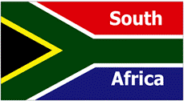
Building South Africa’s Knowledge Access Networks
What they are
Thousands of Internet Cafés, Cyber Cafés, LAN Houses, IPILANS, or anything their young users wish to call them;
Location: Every locality that accommodates the millions of young economically excluded South Africans where joblessness, hopelessness and poverty prevails
Owned, built and operated by the Residents of the settlements, as SMMEs with prices suitable for their community and users
Connected via public and private, if necessary subsidised, broadband networks;
Municipal Wi-Fi Networks as last mile
National public and private fibre or wireless backhaul
Used by the Youth, their parents and relatives, public administration, teachers and all service delivery specialists
Notes:
South Africa (HDI Rank: 120): A Golden Opportunity – A Major Challenge
South Africa’s unique strengths:
The “Cradle” of humankind (Sterkfontein), and Modern Humans (Kalahari);
A Microcosm of a multi-ethnic multi-cultural “colourful” world that finds strength in cultural diversity;
A nation rich in historical experience - a disastrous human history presenting a powerful messages for the future;
A land rich in natural resources – human and other;
A significant “First Economy” that can contribute to “Second Economy” development – if allowed to, and encouraged to do so.
South Africa’s risks:
Failure to raise the national level of human development;
The consequential response of the massive “Second Economy” to its “exclusion” from “First Economy” advantages;
Failure to build the tools required for inclusive human development – affordable effective ICTs.
South Africa’s opportunity: Use the intellectual capacity of South Africa’s “First Economy” to build the ICT infrastructures that will address the knowledge access needs of South Africa’s “Second Economy” – true ICTs4D4ALL, addressing leading edge economic challenges, and developing country demands simultaneously, effectively.

Slide 34
Building South Africa’s Knowledge Access Networks
Who Funds their Construction
State, Provincial and Local Government in Smart Partnership with Private Sector and Civil Society (Concept is “A-Political”);
Assisted by mandated State Agencies like USAASA and its successors, DTI and its SME Development Units, Churches etc.
Why State Funding? The Returns on Investments (ROI) are massive, very long term in nature, socio-economic-political in focus, not suitable for profit-driven commercial investors;
Role of Private Sector? Support in kind, through technological and R&D support, adoption of key installations as part of CSR budgets and commitments;
Role of Academia, R&D, and International Development Agencies: Natural and Social Scientific Research, International Collaboration/Cooperation, Learning Content Development
Notes:
South Africa (HDI Rank: 120): A Golden Opportunity – A Major Challenge
South Africa’s unique strengths:
The “Cradle” of humankind (Sterkfontein), and Modern Humans (Kalahari);
A Microcosm of a multi-ethnic multi-cultural “colourful” world that finds strength in cultural diversity;
A nation rich in historical experience - a disastrous human history presenting a powerful messages for the future;
A land rich in natural resources – human and other;
A significant “First Economy” that can contribute to “Second Economy” development – if allowed to, and encouraged to do so.
South Africa’s risks:
Failure to raise the national level of human development;
The consequential response of the massive “Second Economy” to its “exclusion” from “First Economy” advantages;
Failure to build the tools required for inclusive human development – affordable effective ICTs.
South Africa’s opportunity: Use the intellectual capacity of South Africa’s “First Economy” to build the ICT infrastructures that will address the knowledge access needs of South Africa’s “Second Economy” – true ICTs4D4ALL, addressing leading edge economic challenges, and developing country demands simultaneously, effectively.

Slide 35
Building South Africa’s Knowledge Access Networks
Level and Type of Funding
Budgets: These must depend on local capacity and needs – Each local authority has different quantitative and qualitative needs, to be developed case-by-case
Use of Funds: (1) distribution chains and networks in each locality to canvass donations of used hardware/software; (2) transport and local warehousing; (3) identification and recruitment of young SMME entrepreneurs; Business modelling;
Project Management: Avoid Turn-key execution of the tender variety – they are too risky. Use instead localized innovation hubs, national and local R&D facilities, and set up small specialized management teams within each municipality;
Participation? As a “Bottom-Up” intervention, local participation, especially by local youth, is mandatory…….
Notes:
South Africa (HDI Rank: 120): A Golden Opportunity – A Major Challenge
South Africa’s unique strengths:
The “Cradle” of humankind (Sterkfontein), and Modern Humans (Kalahari);
A Microcosm of a multi-ethnic multi-cultural “colourful” world that finds strength in cultural diversity;
A nation rich in historical experience - a disastrous human history presenting a powerful messages for the future;
A land rich in natural resources – human and other;
A significant “First Economy” that can contribute to “Second Economy” development – if allowed to, and encouraged to do so.
South Africa’s risks:
Failure to raise the national level of human development;
The consequential response of the massive “Second Economy” to its “exclusion” from “First Economy” advantages;
Failure to build the tools required for inclusive human development – affordable effective ICTs.
South Africa’s opportunity: Use the intellectual capacity of South Africa’s “First Economy” to build the ICT infrastructures that will address the knowledge access needs of South Africa’s “Second Economy” – true ICTs4D4ALL, addressing leading edge economic challenges, and developing country demands simultaneously, effectively.

Slide 36
Building South Africa’s Knowledge Access Networks
Technological/Operational Considerations
Innovation: Innovation required is Applied - NOT Technological – concept is technologically neutral – old/modern/future technologies used liberally on case by case and needs basis
Accommodation and Housing: Communities and local governments decide based on availability and needs: Overheads like rentals driven down drastically: Concept of IPLAN in Shack or Spaza Shop to be developed;
Other operating costs: Biggest challenge is connectivity – but new models, supported by National Policy and Regulatory Developments, are being introduced – e.g. Municipal Wi-Fi, Broadband and Project Isizwe models; See Video here
Profitability? Business modelling must/will recognise local affordability – build sustainable but very low cost price models
Notes:
South Africa (HDI Rank: 120): A Golden Opportunity – A Major Challenge
South Africa’s unique strengths:
The “Cradle” of humankind (Sterkfontein), and Modern Humans (Kalahari);
A Microcosm of a multi-ethnic multi-cultural “colourful” world that finds strength in cultural diversity;
A nation rich in historical experience - a disastrous human history presenting a powerful messages for the future;
A land rich in natural resources – human and other;
A significant “First Economy” that can contribute to “Second Economy” development – if allowed to, and encouraged to do so.
South Africa’s risks:
Failure to raise the national level of human development;
The consequential response of the massive “Second Economy” to its “exclusion” from “First Economy” advantages;
Failure to build the tools required for inclusive human development – affordable effective ICTs.
South Africa’s opportunity: Use the intellectual capacity of South Africa’s “First Economy” to build the ICT infrastructures that will address the knowledge access needs of South Africa’s “Second Economy” – true ICTs4D4ALL, addressing leading edge economic challenges, and developing country demands simultaneously, effectively.

Slide 37
Building South Africa’s Knowledge Access Networks
Usage Considerations
Limitations: Drastically suppress any user determinisms – young users will develop their own relationship with the technology and the experience they derive from it – See www.sakan.org.za
Legal Issues: Prevailing laws, both criminal and civil, must be rigorously enforced, BUT with Great Sensitivity: Corrective and punitive responses to legal breaches in LAN Houses must be developmentally focussed - maximising local participation without the extremes of vigilantism;
Learning Opportunities: The traditional “Top-Down” imparting of information and knowledge must be avoided – the formal school system will provide these. Self and peer-driven highly participative learning must be encouraged/promoted through focussed learning content development
Notes:
South Africa (HDI Rank: 120): A Golden Opportunity – A Major Challenge
South Africa’s unique strengths:
The “Cradle” of humankind (Sterkfontein), and Modern Humans (Kalahari);
A Microcosm of a multi-ethnic multi-cultural “colourful” world that finds strength in cultural diversity;
A nation rich in historical experience - a disastrous human history presenting a powerful messages for the future;
A land rich in natural resources – human and other;
A significant “First Economy” that can contribute to “Second Economy” development – if allowed to, and encouraged to do so.
South Africa’s risks:
Failure to raise the national level of human development;
The consequential response of the massive “Second Economy” to its “exclusion” from “First Economy” advantages;
Failure to build the tools required for inclusive human development – affordable effective ICTs.
South Africa’s opportunity: Use the intellectual capacity of South Africa’s “First Economy” to build the ICT infrastructures that will address the knowledge access needs of South Africa’s “Second Economy” – true ICTs4D4ALL, addressing leading edge economic challenges, and developing country demands simultaneously, effectively.

Slide 38
Building South Africa’s Knowledge Access Networks
Institutional and Structural Considerations
At National Level: A multi-disciplinary multi-stakeholder approach is a critical success criterion: virtually all government institutions, and private sector and civil society organizations, have a role to play in the development and use of pro-poor LAN House communication centres;
Complexity: The ideal stated above is difficult to realize in the short term – small teams highly focussed on the immediate tasks, but with a keen interest on promoting broader long term multi-stakeholder participation is mandatory;
Political Level: The short and long term objectives are strictly a-political, long term failure in defeating the triple scourges of inequality, poverty and youth exclusion will have disastrous outcomes for the nation and all/any political ideology or party
Notes:
South Africa (HDI Rank: 120): A Golden Opportunity – A Major Challenge
South Africa’s unique strengths:
The “Cradle” of humankind (Sterkfontein), and Modern Humans (Kalahari);
A Microcosm of a multi-ethnic multi-cultural “colourful” world that finds strength in cultural diversity;
A nation rich in historical experience - a disastrous human history presenting a powerful messages for the future;
A land rich in natural resources – human and other;
A significant “First Economy” that can contribute to “Second Economy” development – if allowed to, and encouraged to do so.
South Africa’s risks:
Failure to raise the national level of human development;
The consequential response of the massive “Second Economy” to its “exclusion” from “First Economy” advantages;
Failure to build the tools required for inclusive human development – affordable effective ICTs.
South Africa’s opportunity: Use the intellectual capacity of South Africa’s “First Economy” to build the ICT infrastructures that will address the knowledge access needs of South Africa’s “Second Economy” – true ICTs4D4ALL, addressing leading edge economic challenges, and developing country demands simultaneously, effectively.

Slide 39
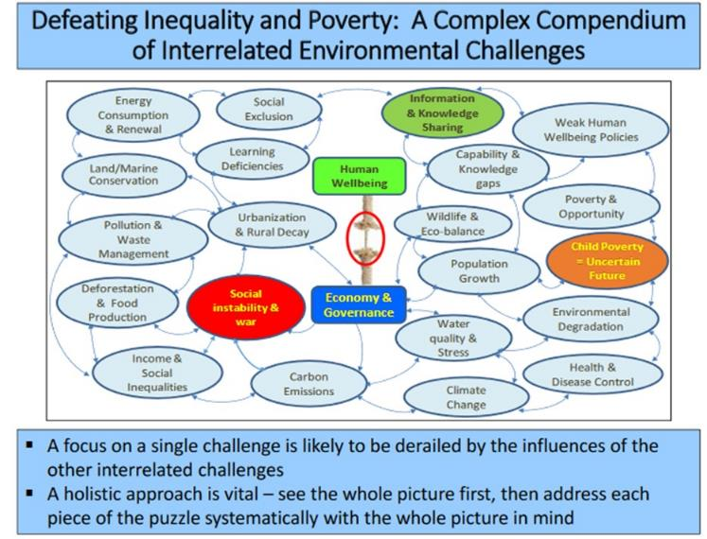
A Review of the Complexity (1)
http://www.sakan.org.za/SAKAN%20Complexities.pdf
Notes:
South Africa (HDI Rank: 120): A Golden Opportunity – A Major Challenge
South Africa’s unique strengths:
The “Cradle” of humankind (Sterkfontein), and Modern Humans (Kalahari);
A Microcosm of a multi-ethnic multi-cultural “colourful” world that finds strength in cultural diversity;
A nation rich in historical experience - a disastrous human history presenting a powerful messages for the future;
A land rich in natural resources – human and other;
A significant “First Economy” that can contribute to “Second Economy” development – if allowed to, and encouraged to do so.
South Africa’s risks:
Failure to raise the national level of human development;
The consequential response of the massive “Second Economy” to its “exclusion” from “First Economy” advantages;
Failure to build the tools required for inclusive human development – affordable effective ICTs.
South Africa’s opportunity: Use the intellectual capacity of South Africa’s “First Economy” to build the ICT infrastructures that will address the knowledge access needs of South Africa’s “Second Economy” – true ICTs4D4ALL, addressing leading edge economic challenges, and developing country demands simultaneously, effectively.

Slide 40
A Review of the Complexity (2)
http://www.sakan.org.za/SAKAN%20Complexities.pdf
Notes:
South Africa (HDI Rank: 120): A Golden Opportunity – A Major Challenge
South Africa’s unique strengths:
The “Cradle” of humankind (Sterkfontein), and Modern Humans (Kalahari);
A Microcosm of a multi-ethnic multi-cultural “colourful” world that finds strength in cultural diversity;
A nation rich in historical experience - a disastrous human history presenting a powerful messages for the future;
A land rich in natural resources – human and other;
A significant “First Economy” that can contribute to “Second Economy” development – if allowed to, and encouraged to do so.
South Africa’s risks:
Failure to raise the national level of human development;
The consequential response of the massive “Second Economy” to its “exclusion” from “First Economy” advantages;
Failure to build the tools required for inclusive human development – affordable effective ICTs.
South Africa’s opportunity: Use the intellectual capacity of South Africa’s “First Economy” to build the ICT infrastructures that will address the knowledge access needs of South Africa’s “Second Economy” – true ICTs4D4ALL, addressing leading edge economic challenges, and developing country demands simultaneously, effectively.

Slide 41
What to Expect from IPILANS
Attack Inequality from the Bottom Up:
South Africa has the highest levels of inequality in the world: See charts at www.sakan.org.za
Attack Extreme Poverty from the Bottom Up:
Almost two-thirds of children in SA live below the upper band of the poverty line‚ according to the 2016 issue of the SA Child Gauge report – Sunday Times 22 November 2016
Attack Child Exclusion and Deprivation of Opportunity:
Too many children living in poverty – below the national poverty lines. Many are not at school, unemployed, and unemployable;
Too many have little option but to resort to drugs and crime
The education system does not help them, at any level – see #FeesMustFall
See inequality in Education: “Some Children are more Equal than Others: https://www.youtube.com/watch?v=hiEUu-Is0Ao
Address all Human Development challenges, including health, racism, wealth, from the Base of the South African People Pyramid
Notes:
South Africa (HDI Rank: 120): A Golden Opportunity – A Major Challenge
South Africa’s unique strengths:
The “Cradle” of humankind (Sterkfontein), and Modern Humans (Kalahari);
A Microcosm of a multi-ethnic multi-cultural “colourful” world that finds strength in cultural diversity;
A nation rich in historical experience - a disastrous human history presenting a powerful messages for the future;
A land rich in natural resources – human and other;
A significant “First Economy” that can contribute to “Second Economy” development – if allowed to, and encouraged to do so.
South Africa’s risks:
Failure to raise the national level of human development;
The consequential response of the massive “Second Economy” to its “exclusion” from “First Economy” advantages;
Failure to build the tools required for inclusive human development – affordable effective ICTs.
South Africa’s opportunity: Use the intellectual capacity of South Africa’s “First Economy” to build the ICT infrastructures that will address the knowledge access needs of South Africa’s “Second Economy” – true ICTs4D4ALL, addressing leading edge economic challenges, and developing country demands simultaneously, effectively.

Slide 42
Case Study Summaries
South Korea: 1st “Dial-up” PC Bang in 1998 ➔ ±12,000 by 2014
Most connected nation on earth: >82% households with multiple PCs;
Still, public PC Bangs remain popular: “Professional” e-Sport league, massive earnings + economic contribution
China: <10% households with PC in year 2000, > 50% by 2015
High PC prices/poor quality, low ICT literacy drove IP cafés to > 20,000 by 2010;
>10,000 closed 2010 to 2013 with growing PC + smartphone ownership
Massive re-growth from 2013 – driven by e-Sport + professional leagues: 146,000 with 20 million daily users by 2015…
Brazil: Favela Rising: the entrepreneurial spirit of Brazil’s slums
Favela (Slum) mid/high income group rose from 3% in 2013 to 7% in 2015
Growth of broadband internet use, via LAN House, a major factor
United Nations family uses LAN Houses to foster protection of women and girls from abuse (click for details) – Also read article by researcher David Nemer Here
South Africa: Too few public internet cafés for poor communities:
One hour Internet access in mid-income based internet cafés costs more than daily household incomes of 30 million South Africans
Pro-poor public internet access provided mainly by immigrants (see Slide 22)
Urgent need to provide large-scale internet access to marginalized youth
Notes:
South Africa (HDI Rank: 120): A Golden Opportunity – A Major Challenge
South Africa’s unique strengths:
The “Cradle” of humankind (Sterkfontein), and Modern Humans (Kalahari);
A Microcosm of a multi-ethnic multi-cultural “colourful” world that finds strength in cultural diversity;
A nation rich in historical experience - a disastrous human history presenting a powerful messages for the future;
A land rich in natural resources – human and other;
A significant “First Economy” that can contribute to “Second Economy” development – if allowed to, and encouraged to do so.
South Africa’s risks:
Failure to raise the national level of human development;
The consequential response of the massive “Second Economy” to its “exclusion” from “First Economy” advantages;
Failure to build the tools required for inclusive human development – affordable effective ICTs.
South Africa’s opportunity: Use the intellectual capacity of South Africa’s “First Economy” to build the ICT infrastructures that will address the knowledge access needs of South Africa’s “Second Economy” – true ICTs4D4ALL, addressing leading edge economic challenges, and developing country demands simultaneously, effectively.

Slide 43
Concluding Thoughts of Two Eminent South Africans
See Video about Tobias here (Adult – Nudity)
Notes:
South Africa (HDI Rank: 120): A Golden Opportunity – A Major Challenge
South Africa’s unique strengths:
The “Cradle” of humankind (Sterkfontein), and Modern Humans (Kalahari);
A Microcosm of a multi-ethnic multi-cultural “colourful” world that finds strength in cultural diversity;
A nation rich in historical experience - a disastrous human history presenting a powerful messages for the future;
A land rich in natural resources – human and other;
A significant “First Economy” that can contribute to “Second Economy” development – if allowed to, and encouraged to do so.
South Africa’s risks:
Failure to raise the national level of human development;
The consequential response of the massive “Second Economy” to its “exclusion” from “First Economy” advantages;
Failure to build the tools required for inclusive human development – affordable effective ICTs.
South Africa’s opportunity: Use the intellectual capacity of South Africa’s “First Economy” to build the ICT infrastructures that will address the knowledge access needs of South Africa’s “Second Economy” – true ICTs4D4ALL, addressing leading edge economic challenges, and developing country demands simultaneously, effectively.

Slide 44
Concluding Thoughts of Two Eminent South Africans
"I am an African"
Notes:
South Africa (HDI Rank: 120): A Golden Opportunity – A Major Challenge
South Africa’s unique strengths:
The “Cradle” of humankind (Sterkfontein), and Modern Humans (Kalahari);
A Microcosm of a multi-ethnic multi-cultural “colourful” world that finds strength in cultural diversity;
A nation rich in historical experience - a disastrous human history presenting a powerful messages for the future;
A land rich in natural resources – human and other;
A significant “First Economy” that can contribute to “Second Economy” development – if allowed to, and encouraged to do so.
South Africa’s risks:
Failure to raise the national level of human development;
The consequential response of the massive “Second Economy” to its “exclusion” from “First Economy” advantages;
Failure to build the tools required for inclusive human development – affordable effective ICTs.
South Africa’s opportunity: Use the intellectual capacity of South Africa’s “First Economy” to build the ICT infrastructures that will address the knowledge access needs of South Africa’s “Second Economy” – true ICTs4D4ALL, addressing leading edge economic challenges, and developing country demands simultaneously, effectively.

Slide 45
Only with Knowledge for ALL can South Africa Enjoy her magnificence and overcome her blemishes
Thank You
walterbrown@afrihost.co.za
Notes:
South Africa (HDI Rank: 120): A Golden Opportunity – A Major Challenge
South Africa’s unique strengths:
The “Cradle” of humankind (Sterkfontein), and Modern Humans (Kalahari);
A Microcosm of a multi-ethnic multi-cultural “colourful” world that finds strength in cultural diversity;
A nation rich in historical experience - a disastrous human history presenting a powerful messages for the future;
A land rich in natural resources – human and other;
A significant “First Economy” that can contribute to “Second Economy” development – if allowed to, and encouraged to do so.
South Africa’s risks:
Failure to raise the national level of human development;
The consequential response of the massive “Second Economy” to its “exclusion” from “First Economy” advantages;
Failure to build the tools required for inclusive human development – affordable effective ICTs.
South Africa’s opportunity: Use the intellectual capacity of South Africa’s “First Economy” to build the ICT infrastructures that will address the knowledge access needs of South Africa’s “Second Economy” – true ICTs4D4ALL, addressing leading edge economic challenges, and developing country demands simultaneously, effectively.

